Slide 1

Quickly Build a Predictive Chatbot With
IBM Cloud
Watson Machine Learning
Watson Conversation
Sam Ennis
Client Technical Solutions Specialist
Analytics Platform Cloud Offerings
Sam.Ennis@ibm.com
October 2017
Notes:
I’m going to show you today through my demo – walking through how I built it, just one of the ways you can use the IBM Cloud platform, to create smart, Machine Learning and Artificial Intelligence-infused applications very quickly == applications that we call Cognitive Applications. I'm sure some of you tuning in are already using IBM Cloud, and some are interested and hoping to learn how to get started. My goal is for this demo to be valuable for broth groups.
So IBM Cloud provides you with that foundation to help you get up and running quickly when it comes to either creating new applications or augmenting you existing applications with ML and AI capabilities.
And ultimately, after the webinar today, myself and IBM we look forward to continuing the conversation with you to start identify areas of opportunity with your business that are high impact. Where we can really focus to help drive value for you and help make an impact for your company.

Slide 2

The real value of data is being able to extract meaningful insight, to make more informed decisions, and to create differentiating, predictive business models.
Notes:
So the whole motivation behind Cognitive Applications, and a good place to start this conversation is DATA.
Right now there’s is more data from more sources than ever before, -- and lots of it! being generated every single day.
A statistic that I find fascinating
90% of the data in the word today has been created in the last two years alone
Accelerating
People, businesses, devices, are like data factories, constantly pumping out data
So, as a business or organization. your have data about a lot of different things that could be valuable. Your products and how they've sold, your inventory, your customers, your interactions with them on your website, on Social Media, data from different devices like smartphones.
One thing to have the data, another to gain meaningful insight from it.
Some of that data is structured in rows and columns you can use traditional technicques to analyze it, but oftentimes some of is unstructured and can be tricky to get meaning from.
The cool thing about Watson is that it can help you tap into the new data sources, dark data into usable data. Video, unstructured text documents, conversations with customers = traditionally dark data. Turning dark data into usable insightful data into action.
Today, only 15% of organizations have the capability to leverage data and advanced analytics across their organization. (HBR Insight Economy Study).
- We need to be able to understand it, reason about it, learn from it, and use it. And that’s where cognitive applications come in. Enabling your smart applications that can leverage these capabilies.
And one of these areas, that I'm going to be focused on today in the demo: is creating a more personalized experience for your customers
So there’s a huge competitive advantage here for organizations that can leverage data in more meaningful ways.
Those organizations that can move fast -- that have an idea for a cognitive application, and are set up to build them quickly. It’s really valuable.
https://public.dhe.ibm.com/common/ssi/ecm/wr/en/wrl12345usen/watson-customer-engagement-watson-marketing-wr-other-papers-and-reports-wrl12345usen-20170719.pdf

Slide 3
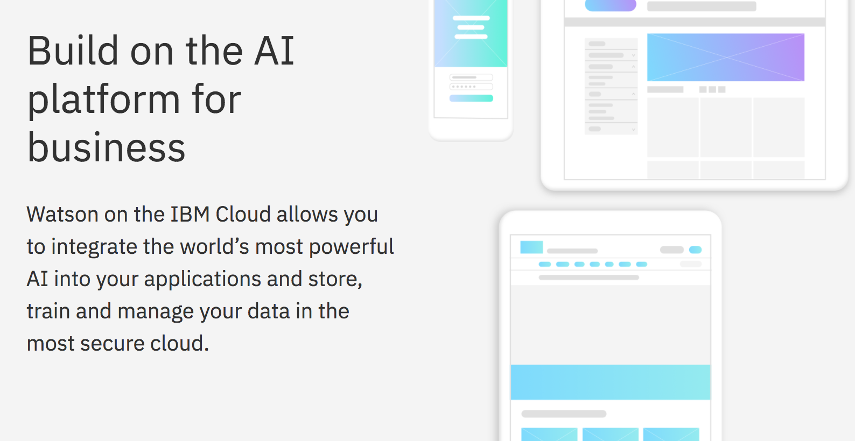
Build on the cognitive platform for business
IBM Cloud enables you to integrate powerful analytics and AI into your applications.
Notes:
So IBM Cloud is the cloud platform for the data-driven enterprise.
IBM's cloud is the cloud for business. It's designed for data, AI-ready, and secure to the core. Drive innovation and Business Value.
The IBM Cloud platform consists of a set of composable services.
You can think of the services like Legos that we can help you fit together to create the best solution for you. They’re pluggable services that can be integrated together easily. Or augment existing applications.
My demo today -- the predictive chat bot -- uses a few of these services in a pluggable fashion. Our Machine Learning service to deploy a predictive model, our Watson Conversation service to create a chatbot, and NODE-Red, which lets me quickly wire together these services to create a web application.
So in a moment, I’m going to dive into the business use case that motivated the development of the predictive chatbot.
Before I do though, I’ll mention that's the really neat thing about the IBM Cloud platform. You can think of a business use case, spin up the specific set of services you need within the platform -- maybe an app runtime, a database, a Watson "cogntive" service -- and get the MVP done very quickly. It's an agile approach to innovation.
I’ll show you in just a minute what that final product looks like. First I’ll talk about the scenario behind the demo:

Slide 4
Demo Scenario – Building a Predictive Chatbot
Fitness Club USA is a national gym chain
They want to get their members to sign up for more fitness classes (cross-sell opportunity) by offerings personalized recommendations
They want to enhance customer experience by providing a personalized interface for customers across multiple channels of interaction
Notes:
So the predictive chatbot I built is for a nation wide gym chain called Fitness Club USA, and though the motivation and scenario is based on realistic situations-- Fitness Club USA is a fictional chain. So if after the demo today, I've convinced you to buy a membership, you will have to look at some alternatives.
Business use cases that they are looking to address:

Slide 5
Let’s visit Fitness Club USA’s new cognitive website…
Notes:
I would like to lose some weight
Show your phone receiving a text from Twilio.

Slide 6
IBM Cloud Services used to build Fitness Club USA’s app
Flow-based programming on Node.js runtime
HTTP (REST)
HTTP (REST)
Data Science Experience
Watson Machine Learning
Watson Conversation
Create ML models using a variety of tools and frameworks (Python, Spark, SPSS)
Deploy ML models to RESTful endpoint for scoring
Continuous monitoring and feedback of ML models in production
API to build a chat bot from the ground up to be used across multiple channels
Understands natural-language and responds to customers in human-like conversation
Integrated dialog builder to easily construct dialog flows
Node-RED
HTTP (REST)
Cloudant
Notes:
IBM Cloud services -- those building blocks to build this app.
1. WML
What is ML?
““Computers that learn without being explicitly programmed, using algorithms to understand patterns in data”
Explicitly= Years ago, “if/then” conditions. Can’t code conditions for massive amounts of data.
Known formulas:
Recommenders, decision trees, linear regression
Data, train a model based on data you have, I get a predictive model for the future. For future data coming in, I can make a prediction.
That algorithm becomes a competitive advantage for your company. Something you can deploy to make predictions and decisions.
Substantial impact across industries and use cases.
Range:
Optimize usage of products
Predictive maintenance
Forecasting
Operations (supply chain)
PERSONALIZATION today
Recommendation to a customer.... you just saw was the Zumba!
Traditionally it can be very tricky to take a predictive model and deploy it in production. Gap between the data scientists creating and those who would deploy that. You can have the best model in the world, but it can be tricky to deploy that model in an effective, scalable way to be leveraged by different applications operationally.
That's what WML solves. By letting you deploy you ML model to a RESTful service. So now I can send HTTP requests from my app to get a predictive score.
DSX
DSX is the dev environment for building models for Watson Machine Learning
Collaborative service for data scientists to use tools like Python, R, Apache Spark to perform data science and create machine learning models
Or, what I’ll show you today... is more of a ML model wizard interface that lets me create a model without needing to program. With a really simple to use GUI interface.
DSX + WML overall: (clicks for bullet points)
Watson Conversation Service (clicks)
1. With Watson Conversation you can have a conversational interface across multiple channels to communicate and engage with your users — customers or internal.
2. Through this service, Watson process the user’s input to understand the intent of a user's phrase or question and provide an appropriate response. As part of natural language processing, Watson is trained to narrow down the intent of a sentence to be its underlying meaning or goal—ultimately, to grasp what someone means, regardless of how they say it. There are many different ways to utter the same intent: "Turn on the lights," "I can't see because it's too dark," and "Illuminate" all express the same desire to brighten up a room. With your help — and I’ll show you what the looks like — Watson can be trained to understand the many ways that a particular question relevant to your application or domain or business can be posed and take it from there.
3. Ease of constructing dialogs. Which I’ll show in the demo. The theme of the demo today is getting up and running as quick as possible. Very helpful to have the GUI-based editor that can help me be effective very quickly.
Node-RED
My glue that ties these services together in an effective manner.
1. Flow-based programming tool, original developed by IBM but contributed back to open source. Basically lets you quickly wire together different APIs and services web applications on top of a Node.js runtime. Great way to visually put together proof of concepts– idea, try it out. fail fast approach. We provide you the runtime in IBM Cloud, and we also have lots of prebuild nodes in the GUI interface for IBM Cloud services. It is visual, do need to be a little familiar with Javascript… also its effective for trying out new things, creating demos, but typically in production you would want to go with a different run-time in IBM Cloud.
Cloudant
Then Cloudant is supporting my website as a database. Cloudant is a scalable NoSQL database for web applications. I use it to store customer records in the database.
All communicate via RESTful API.
And as I said, Node-RED is the glue here: At what point in the conversation do I want to call the ML model, do I want to grab customer information, etc.

Slide 7
IBM Cloud Catalog
Find these services and more in the…
https://console.bluemix.net/catalog/
Notes:
https://console.bluemix.net/catalog/
Brief catalog overview…
Spin up new Watson Conversation service.
Show on Dashboard

Slide 8


Demo Overview – Building a Predictive Chatbot
RESTful Web Service
Customer Data
Data Science Experience
Fitness Class Recommendation Model
Watson Machine Learning
RESTful Web Service
Watson Conversation
Trained Chatbot
Node-RED
Web Application

Slide 9
Step #1 – Create & Deploy ML Model
RESTful Web Service
Customer Data
Data Science Experience
Fitness Class Recommendation Model
Watson Machine Learning
Notes:
Dataset in Excel
Previous sign ups/survey data for my fitness classes.
Think about for your company what the products might be. Just showing one example.
Recommending a product.
Likelihood of churn, etc.
Create a historical model. Might use SPSS, SAS, Python to build a model. But historically it can be tricky to put that model in production.
DSX environment
Use the model builder. Create a ML model — SparkML, Scikit Learn, XGBoost, expanding more
Multiple ways to do this:
Python, R, — create my model with code, data preparation, more control. Python API to load my model.
Easy — “ML wizard”
Load data. Select models.
TODO Fill time here:
“Continue to customize further. More ML models, more IBM Cloud services, Watson Services”
Customer service — add a chatbot that automatically respond to your customers’ most frequently asked questions
Mobile apps - Allow your customer to control your mobile app using NLU virtual agents
Messaging channels - Built Twitter, Slack, Facebook Messenger Bots that interface instantly with users
IoT — power connected devices to understand language and respond to users’ commands
Robots — Power robots with NLU and conversational capabilities
Evaluated models. Pick the one to deploy.
Score the model at its API endpoint with Postman.
- Show two different scorings! M vs F. Yoga and Zumba.

Slide 10
Step #2 – Train Chatbot
RESTful Web Service
Customer Data
Data Science Experience
Fitness Class Recommendation Model
Watson Machine Learning
RESTful Web Service
Watson Conversation
Trained Chatbot
Notes:
Watson Conversation
Introduction:
With Watson Conversation you can have a conversational interface across multiple channels to communicate and engage with your users — customers or internal.
Help train Watson on what it can expect in terms of intents, entities, and dialog flow when speaking to customers.
“Goal—ultimately, to grasp what someone means, regardless of how they say it.”
Understand what people say, the true intent behind what someone means
Train Watson on a set of utterances or sentences, express themselves in Natural Language
Understand what it is they want to accomplish, or what their “intent” is.
Then that is accessed similarly via REST API, integrate in my app is the Watson Conversation service
Allow users to make chatbots
New:
Already created a dialog with the fitness chatbot. But I wanted to start from scratch, just to show you what that looks like.
Test these throughout with the sample chatbot.
Verbs = Intents
Nouns = Entities
Dialog flow = piece together these
Watson will use NLP in order to interpret and classify what the user said.
Intents:
#sign_up_for_class
Examples:
“I want to sign up for a class”
”I’d like to join yoga.”
“Can you add me to the list for the spin class?”
Try out:
Can I join the fitness bootcamp?
Sign me up for pilates.
#cancel_membership
Examples:
I’d like to cancel my membership
I don’t want to be a member anymore
Try out:
I want to drop my membership
@fitness_activity
Value: “weightlift” : “lift”, “lifting”, “pumping iron”
Value: “run”: : “jog” “sprinting”, “cross country”
Flow:
#sign-up-for-class and @fitness_activity:running
Sample:
“Sign me up for the running class!”
“Can I join in on the jogging?
Define how I want my conversation to go
Note: I can have multiple responses to each node.
Walk through existing conversation
Very simple in terms of intents and entities:
Did not define too much in terms of Intents:
#achieve_a_fitness_goal
Entities:
@goal:
Walk through the synonyms
@yesno:
Since I am asking quite a few yes/no questions of them.
@phonenumber:
Define with regular expression
Flow:
Pretty straigthforward here, too.
Filler:
Customer service — add a chatbot that automatically respond to your customers’ most frequently asked questions
Mobile apps - Allow your customer to control your mobile app using NLU virtual agents
Messaging channels - Built Twitter, Slack, Facebook Messenger Bots that interface instantly with users
IoT — power connected devices to understand language and respond to users’ commands
Robots — Power robots with NLU and conversational capabilities

Slide 11
Step #3 – Put it together with Node-RED
RESTful Web Service
Customer Data
Data Science Experience
Fitness Class Recommendation Model
Watson Machine Learning
RESTful Web Service
Watson Conversation
Trained Chatbot
Node-RED
Web Application
Notes:
So those are the core services. The ML model and the Chatbot.
Node-RED is our glue to piece these together into a web application. Palatte to the left. All sorts of services. Highlight Watson.
Node-RED
Take both of these REST API calls and make them one. Show a NODE Red #1 of what this scoring looks like from Postman.
(Brief intro to NodeRED).
Open Source tool
Excellent to quickly get up and running and wire together RESTful services for demos
Show “Deploy” the flow.
Watson ML Example.
HTTP Request. API endpoint. Response.
Javascript functions in between.
Watson Conversation Example
Send with Postman.
You can see intents, entities, etc. that are returned.
3. The way I add my logic to put these together is through a “Switch”. Node can help me take an action based on where I am in the conversation.
Key is making decisions to perform actions based on what information Conversation returns. Switch statement. I did it it on Nodes, but you could easily do this with intents, entities, thresholds, etc.
1 Switch is for the Machine Learning component.
1 Is for Scoring a ML model
1 to get data from my database (Cloudant)
Show Cloudant
Then the otherwise is for a normal response.
Persist: Point out Conversation Context. Keep passing. Stores where you are in the convo between your requests, any state variables
Persist: Saving CC and others on the Server side as well. Global variable in NodeRED. I’ll have that customer info stored server side to get ready for scoring my model.
4. Take a look at the complete flow
FRONT END: Walk through Convo until get record from the Cloudant database.
EXTRA BONUS:
The beauty of IBM Cloud and NodeRED, is I can keep adding in these APIs very easily. Extra bonus
Added in Tone Analyzer!
Extra bonus: NR #5 — just tone analysis (view message objects)
Bonus at the end: “This is horrible!!!” or “I hate this!”
Back to demo overview page.

Slide 12
Bonus Step – Augment With Additional Services
RESTful Web Service
Watson Tone Analyzer
Customer Data
Twilio (3rd Party)
Data Science Experience
Fitness Class Recommendation Model
Watson Machine Learning
RESTful Web Service
Watson Conversation
Trained Chatbot
Node-RED
Web Application
Notes:
So those are the core services. The ML model and the Chatbot.
Node-RED is our glue to piece these together into a web application. Palatte to the left. All sorts of services. Highlight Watson.
Node-RED
Take both of these REST API calls and make them one. Show a NODE Red #1 of what this scoring looks like from Postman.
(Brief intro to NodeRED).
Open Source tool
Excellent to quickly get up and running and wire together RESTful services for demos
Show “Deploy” the flow.
Watson ML Example.
HTTP Request. API endpoint. Response.
Javascript functions in between.
Watson Conversation Example
Send with Postman.
You can see intents, entities, etc. that are returned.
3. The way I add my logic to put these together is through a “Switch”. Node can help me take an action based on where I am in the conversation.
Key is making decisions to perform actions based on what information Conversation returns. Switch statement. I did it it on Nodes, but you could easily do this with intents, entities, thresholds, etc.
1 Switch is for the Machine Learning component.
1 Is for Scoring a ML model
1 to get data from my database (Cloudant)
Show Cloudant
Then the otherwise is for a normal response.
Persist: Point out Conversation Context. Keep passing. Stores where you are in the convo between your requests, any state variables
Persist: Saving CC and others on the Server side as well. Global variable in NodeRED. I’ll have that customer info stored server side to get ready for scoring my model.
4. Take a look at the complete flow
FRONT END: Walk through Convo until get record from the Cloudant database.
EXTRA BONUS:
The beauty of IBM Cloud and NodeRED, is I can keep adding in these APIs very easily. Extra bonus
Added in Tone Analyzer!
Extra bonus: NR #5 — just tone analysis (view message objects)
Bonus at the end: “This is horrible!!!” or “I hate this!”
Back to demo overview page.

Slide 13
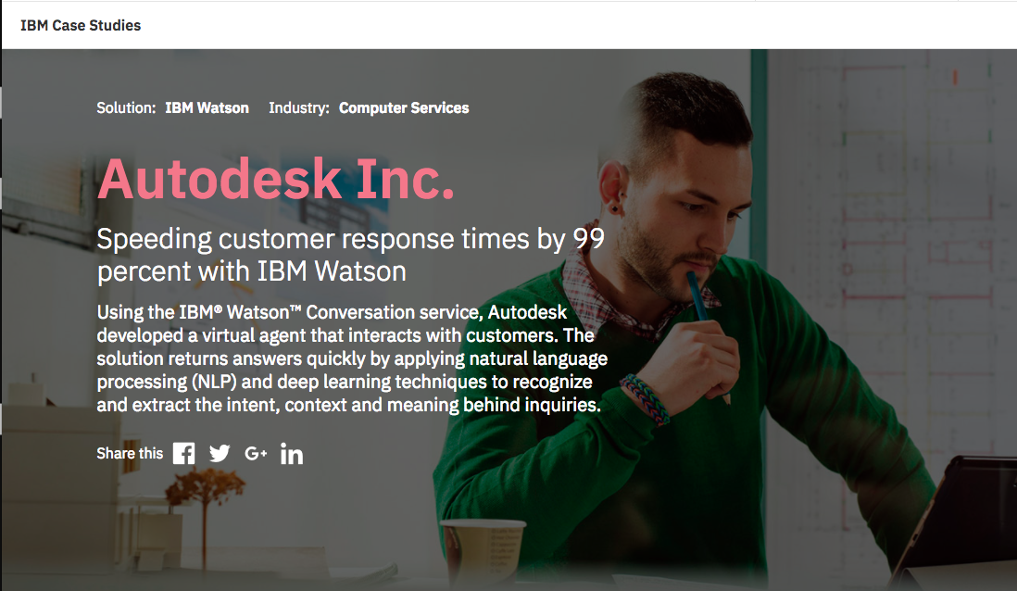
http://ecc.ibm.com/case-study/us-en/ECCF-WUC12544USEN
Notes:
What does a business leveraging a cognitive application look like?
http://ecc.ibm.com/case-study/us-en/ECCF-WUC12544USEN
Autodesk Virtual Agent
TODO: fill this in.
Recognizing that shifting to a subscription business model requires real-time customer service and support, Autodesk sought to use cognitive technology to enhance its customer experience.
For more than 34 years, software giant Autodesk sold its popular 3D design, engineering and entertainment software under perpetual desktop licensing agreements. However, the way customers want to buy and access products is changing—from working with desktop applications to using software hosted on cloud and mobile platforms.
Using the IBM Watson Conversation Service, Autodesk built a virtual agent that interacts with customers and returns answers quickly by recognizing the intent and context behind inquiries.
Using the IBM® Watson™ Conversation service, Autodesk developed a virtual agent that interacts with customers. The solution returns answers quickly by applying natural language processing (NLP) and deep learning techniques to recognize and extract the intent, context and meaning behind inquiries.
Results
Supports 20,000 conversations
per month, easing the burden on call center staff
Recognizes 40 distinct use cases
to quickly resolve easy requests so that agents can focus on helping customers with complex issues
Cuts resolution time drastically
from 1.5 days to just 5.4 minutes for most inquiries
--------
Although the move makes sense for Autodesk—customers can save money, avoid long-term agreements and benefit more quickly from product updates—it also has a profound effect on customer service.
What’s more, it raises the stakes for attracting and retaining new and would-be customers because the purchase experience often begins with a trial. “If a software trial doesn’t work properly, they’ll never become a customer,” says Spratto.
Currently, Autodesk maintains a staff of about 350 internal and external customer support agents who handle roughly one million customer and partner contacts per year, half of which pertain to activation code requests, changes of address, contract problems and technical issues. “A lot of what my team does is just problem recognition, trying to identify what the person wants or is asking,” explains Spratto, who manages both customer and partner service worldwide. Due to the heavy volume and complexity of the issues, the current resolution time for inquiries can be 1.5 days or more.
As a result, agents are under less pressure and can focus on more complex issues, such as helping customers understand how to use some of the products’ more sophisticated features and functionalities.

Slide 14

Build on the cognitive platform for business
with IBM Cloud
Sam Ennis
sam.ennis@ibm.com
Client Technical Solutions Specialist
Analytics Platform Cloud Offerings
Sign up for IBM Cloud:
https://console.bluemix.net/registration/
Instructions to set up this app yourself:
https://github.com/samcennis/Watson-Conversation-ML-Demo
Notes:
Now I’d like to open it up to questions from the chat.
??????
Thank you everyone.
I hope I've opened up your mind to the possibilities of what IBM Cloud can help your organization achieve, and you're excited about ways that we can help drive value for you with your use of data and analytics. Thanks again for tuning, and we hope to speak with you soon.
Use case tied directly to business value profit
Sales forecasting and inventory optimization using weather data
Speaks broadly to digital disruption and the value of data
Opening presentation can be modified for other industries/use cases
Storyline that holds interest
Interesting patterns in the data, anecdotes
Comprehensive and end-to-end, yet message of simplicity
Great recognition and feedback so far
From webinar last week: “outstanding job”, “…this is one of the best I have seen!!”

Slide 16


Managing the deployment of traditional machine learning models is challenging due to a lack of tooling & collaboration
How does Watson Machine Learning help?
How can I share my models and collaborate with app developers?
How do I deploy this model into multiple applications?
How do I manage my models in production?
Is the model still valid? How do we manage the lifecycle?
Data Scientist
App Developer
RESTful Web Services

Slide 17
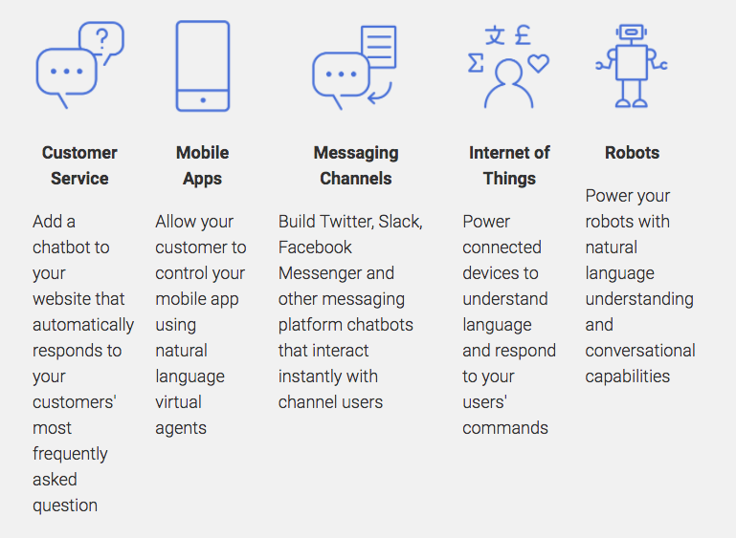
What can I use the Watson Conversation Service for?

Slide 18




IBM Watson Data Platform
Business Analysts
Unified Governance
Hybrid Data Management
Data Analytics & Visualization
Data Scientists
Data Science
& Machine Learning
Enable better insight and compliance across all data
Unify the approach to data and content on the path to cloud
Empower all to make data-driven decisions quickly and easily
Data Engineers
Embrace new ways to develop insights and streamline operations
Open Source: Hadoop, Spark & more
Commit to openness—for speed and innovation
App Developers
Notes:
We created the Watson Data Platform to address these three key inhibitors that we saw organizations struggling with.
We recognized that data analysis is a team sport, so we created a unified cloud platform of composable data services, where everyone within the organization can work together, and you’ll see on the right there the different types of roles within your organization who are able to easily collaborate on the cloud platform – around common data and workflows.
This platform consists of a set of composable data services, available on the IBM Cloud platform.
(click)
You can think of the services almost like Legos that we can help you fit together to create the best solution for you what’s going to drive the most business value for you. And Watson is in the name because we've infused these services with many of the cognitive capabilities of Watson– and you can also use IBM Cloud to make use of Watson APIs like NLP or sentiment analysis for your own applications data-driven as well.
All of these services are enterprise-ready and benefit from IBM’s vast experience working with businesses, so we’ve created patterns that we know our successful. Cloud lets us manage the complexity for you when it comes to managing and maintaining the infrastructure. We take care of things like high availability, security, and scalability. We can spin up environments very quickly in the cloud, and you can focus on getting value from your data as soon as possible.
We really saw that there were some key elements that organizations needed to embrace when it comes to data and analytics that we’ve included with Watson Data Platform -- and what you'll see in my demonstration.
The first is Hybrid Data management
And that means hybrid in the sense structured/unstructured. As well Cloud/on-prem. Realize there is some data, workflows, or apps your not ready or don’t want to move to cloud, and that’s okay. IBM differentiates when it comes to hybrid cloud environments.
So wherever it resides, whatever type it is, you’re all set.
The second is data analytics and visualizations
Organizations need many-- not just a few-- to be empowered to perform analytics in a self-service fashion. I should be able to gain insights myself without being dependent on just a few power users.
And we’ve got cognitive capabilities to help the “citizen analyst” here, like being able to ask a question in natural language about my data or getting some automated starting points to speed up that time to insight.
Unified Governance
Is the data any good? Relevant? Is it compliant? This is built into the platform as well .
Then Open Source
- We are a huge supporter of Open Source. We realize that companies need to use tools like Apache Spark and Hadoop in order to move quickly and innovate. We also don’t want to feel like you're getting locked in to a proprietary platform. So we differentiate with open APIs and connectors to help to integrate with existing on-premises or other clouds you might be using.
Data Science & Machine Learning
The capability to incorporate deep analytics, predictive analyitics, embed machine learning in your applications to operationalize your analytics.
Maybe you're looking to segment your customers more effectively, predict likelihood of churn, promotion response, etc.
These are all important as well -- and we have a range of offerings depending on the characteristics and preferences of analysts.
All in all, we want the users throughout your organization to be able to collaborate -- to use data and ingrain it into your applications, decision making, and business processes in a simple and easy-to-use fashion -- answering valuable questions for your organization.
Let me show you what that looks like in action with a demo.

Slide 19
What is Machine Learning?
“Computers that learn without being explicitly programmed,
using algorithms to understand patterns in data”
Data
Predictions & Decisions
Models
Algorithms
Notes:
Explicitly= Years ago, “if/then” conditions. Can’t code conditions for massive amounts of data.
Data, train a model based on data you have, predictive model for the future. That algorithm becomes a competitive advantage for your company. Something you can deploy to make predictions and decisions.
Substantial impact across industries and use cases.
Known formulas:
Recommenders, decision trees
Range:
Optimize usage of products
Predictive maintenance
Personalization for customers
Forecasting
Operations (supply chain)
PERSONALIZATION today

Slide 20
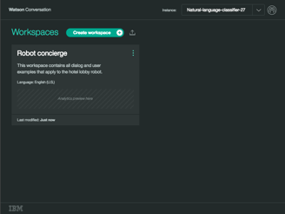
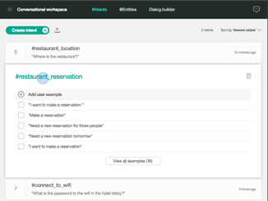
Watson Conversation Service
An API for Developers or Technical LOB that want to BUILD a chat bot or virtual agent from the ground up.
Create conversational experiences across any channel (e.g. mobile, messaging, IoT, etc.)
Integrated dialog builder allows subject matter experts the ability to easily construct dialog flows for chat bots and virtual agents
Combines intents, entities and dialog into a
seamless experience
Includes:
Code samples
Software Development Kits (SDKs)
Access to a broad set of platform services that can augment conversational use cases (e.g. Speech, Empathy)
Enterprise support with the Premium Plan (e.g. data isolation, e2e encryption, PII support)

Slide 21




The IBM foundation for data innovation
Applications, solutions and services
Targeted solutions for enterprise businesses
Healthcare
Financial
Services
Logistics
Data Science
IoT
Virtual agent
AI
Cognitive building blocks for developers
API
Conversation
API
Discovery
API
Compare and Comply
API
DLaaS
API
Tone Analyzer
API
Personality Insight
API
Visual Recognition
API
Speech
API
Document Conversion
API
Nat Language Understanding
API
Nat Language Classifier
…more
Data
Tools to prepare data for cognitive
Ingestion
Storage
Analytics
Deployment
Governance
Cloud Integration
Cognitive Micro-services
DevOps Tooling
Cloud Infrastructure
A highly scalable, security enabled infrastructure
Networking
Compute
Security
Dedicated Compute
Virtual Compute
Object Storage
…more
Public
Hybrid
Private
Notes:
IBM Bluemix is the cloud platform for the data-driven enterprise.
IBM Cloud is the cloud for business. It's designed for data, AI ready and secure to the core. Drive innovation and Business Value.
This platform consists of a set of composable data services, available on the IBM Bluemix cloud.
Set of components available within these layers. Easy to spin up in the cloud for whatever your business need is.
You can think of the services like Legos that we can help you fit together to create the best solution for you what’s going to drive the most business value for you. It's really the platform to help you become a cognitive organization. They’re pluggable services that can be integrated together easily.
Ready for the enterprise deployment. We’ve created patterns that we know are going to be successful for you.
We want to make things simple for you too. Cloud lets us manage the complexity for you when it comes to maintaining and configuring infrastructure. So we take care of things like high availability, security, and scaling that you would have to worry about if you were doing things in house. And its no hassles-- you can focus on getting value from your data as soon as possible. And scale when you need to.
Data Science Experience. + Analytics
Data layer == Leverage data services to store your data
Easily create and deploy applications
Easily augment those applications with Machine Learning models and cognitive AI capabilities
Models you create with DSX
Turn unstructured data into intelligence and competitive advantage
Natural Language understanding
--------
IBM is architecting a cloud-native platform for the cognitive era.
Watson Data Platform is a critical part of it. it builds upon the IBM Cloud Platform services and is the foundation for our own AI services, applications and solutions
This means, as you execute on any initiative, it is easy to draw in, integrate and use the wealth of innovation across the whole IBM cloud.

